Slide 1
Shell Bootcamp 2024 5 Reflections for Week 02
Sushma Singh
Date : 06-Sept-2024

Slide 2

About Me
Be a better version of yourself than Yesterday…
Please share an image / visual that best represents you

Slide 3

My learnings from this week!

Slide 4
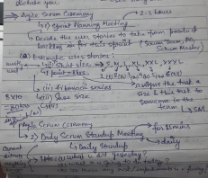
Learning 1 | My takeaways
Key learning: Agile Ceremonies, Gherkin, Azure DevOps
Key takeaway: TDD, BDD, User Story, Test Cases
Adopting Agile in the energy sector benefits professionals by fostering a culture of continuous improvement and flexibility.

Slide 5
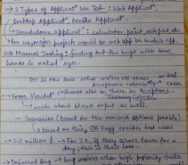
Learning 2 | My takeaways
Key learning: Sprint, Epis, User Stories, Features, Acceptance Criteria
Key takeaway: RTM, DOD, DOR
In the energy sector, understanding the terminology of Agile is a very crucial aspect as it allows one to seamlessly work on the projects where the interaction with team and stakeholders is a must.

Slide 6
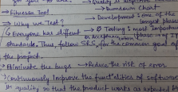
Learning 3 | My takeaways
Key learning: Fitnesse Tool, Testing, STLC
Key takeaway: Defect Report, Defect Life Cycle
In an energy sector, it is quite important to understand how testing takes place and how bugs can be identified and resolved.

Slide 7
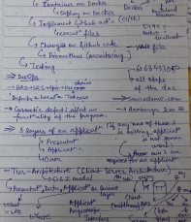
Learning 4 | My takeaways
Key learning: Cloud, DBMS
Key takeaway: CRUD, DDL, DML, DCL, TCL
Understanding cloud and database is very important in the energy sector as you must deal with both - Large number of datasets and functionalities over cloud.

Slide 8
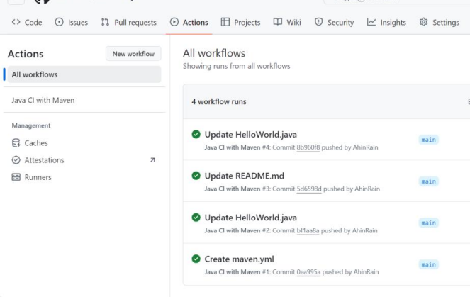
Learning 5 | My takeaways
Key learning: Implementation of CI pipelines, Github Actions, Agile
Key takeaway: Maven, .yml file, pom.xml file
In an energy industry, it is a must to know about CI/CD pipelines and Agile so that one could efficiently work on the projects. Thus, this implementation was very useful for us to understand how things actually work.

Slide 9

Relevance of learnings for my organization

Slide 10

Learning 1 | Relevance for Shell
Shell leverages Agile methodologies and tools like Azure DevOps, Gherkin, and TDD/BDD to enhance collaboration, ensure software quality, and align development with business goals.
By using these practices, Shell can deliver reliable and user-centric software solutions efficiently, supporting its operational and strategic objectives.

Slide 11
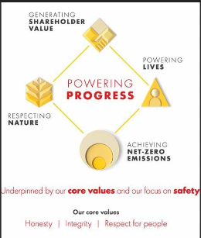
Learning 2 | Relevance for Shell
Shell uses Agile frameworks with elements like Sprints, Epics, and User Stories to structure and prioritize work.
Acceptance Criteria, RTM, DOD, and DOR ensure that development aligns with business objectives and quality standards, facilitating efficient project management and delivery.

Slide 12

Learning 3 | Relevance for Shell
Shell follows the Software Testing Life Cycle (STLC) to ensure software quality.
Defect Reports and the Defect Life Cycle help in tracking and resolving issues promptly, maintaining the reliability and performance of their software solutions.

Slide 13
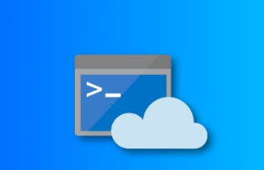
Learning 4 | Relevance for Shell
Shell leverages cloud technologies and database management systems (DBMS) to handle vast amounts of data efficiently.
CRUD operations and SQL commands (DDL, DML, DCL, TCL) are essential for managing and securing data, supporting Shell’s data-driven decision-making processes.

Slide 14
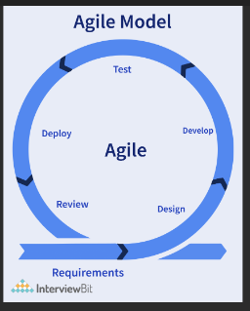
Learning 5 | Relevance for Shell
Shell implements Continuous Integration (CI) pipelines and uses tools like GitHub Actions and Maven to automate and streamline software development.
Agile methodologies and configuration files (.yml, pom.xml) ensure consistent and efficient project builds and deployments.

Slide 15

Challenges in implementing learning

Slide 16
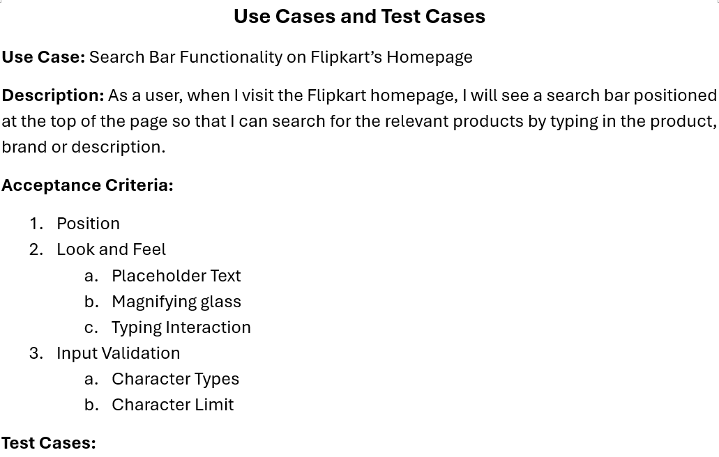
Challenge faced while implementing Learning 1
Challenges: Understanding BDD and TDD and how to make User stories and Test Cases
Plan to Overcome: Practice writing the user stories and test cases to better understand and work on them.
GitHub Link:
https://github.com/AhinRain/Freshers-Technical-Training

Slide 17
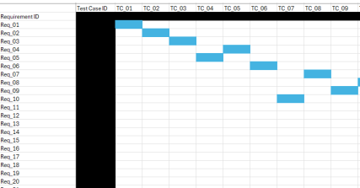
Challenge faced while implementing Learning 2
Challenges: RTM, Features
Plan to Overcome: Learn more about these topics and practice creating RTMs to get better at them.
GitHub Link:
https://github.com/AhinRain/Freshers-Technical-Training

Slide 18
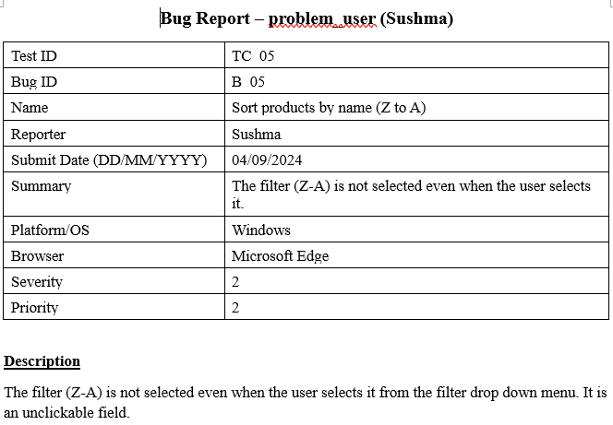
Challenge faced while implementing Learning 3
Challenges: Defect Report and its terminologies
Plan to Overcome: Practice creating Defect Reports for demo websites available such as saucedemo and orangeHRM to get better at them
GitHub Link:
https://github.com/AhinRain/Freshers-Technical-Training

Slide 19
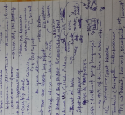
Challenge faced while implementing Learning 4
Challenges: Difference between PostgreSQL, MySQL and SQL
Plan to Overcome: Learn about SQL to understand these concepts better
GitHub Link:
https://github.com/AhinRain/Freshers-Technical-Training

Slide 20
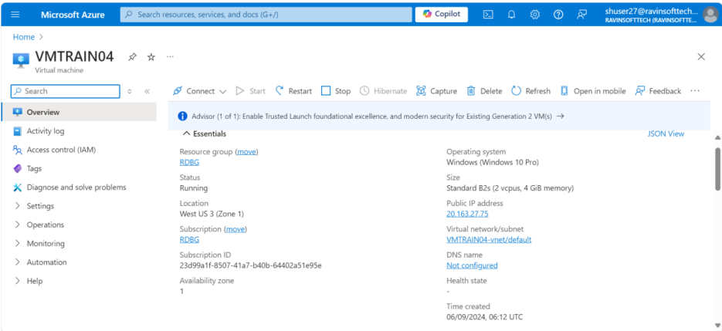
Challenge faced while implementing Learning 5
Challenges: Completing the case study in the allotted time as VM Creation and some other tasks took significant time
Plan to Overcome: Learn about VM creation and the required fields in it so that I can understand the process better and not make any mistakes later.
GitHub Link:
https://github.com/AhinRain/Freshers-Technical-Training

Slide 21

Action Plan

Slide 22
My Action Plan for this Week
Actions
Timeline
Status
Implement the various concepts taught in the class to understand them better
Try to make notes during the sessions to refer to them afterwards
Practice and learn the various concepts on my own as well
The planned timeline to implement the first action is until I understand the concepts better
As for the second one, it is till the training ends
As for the learning part, it will continue even after the training
Implemented most of the concepts that were taught in the class
Made notes for all the sessions conducted
Learnt about the various concepts after the sessions

Slide 23

Learning is also Fun!

Slide 24
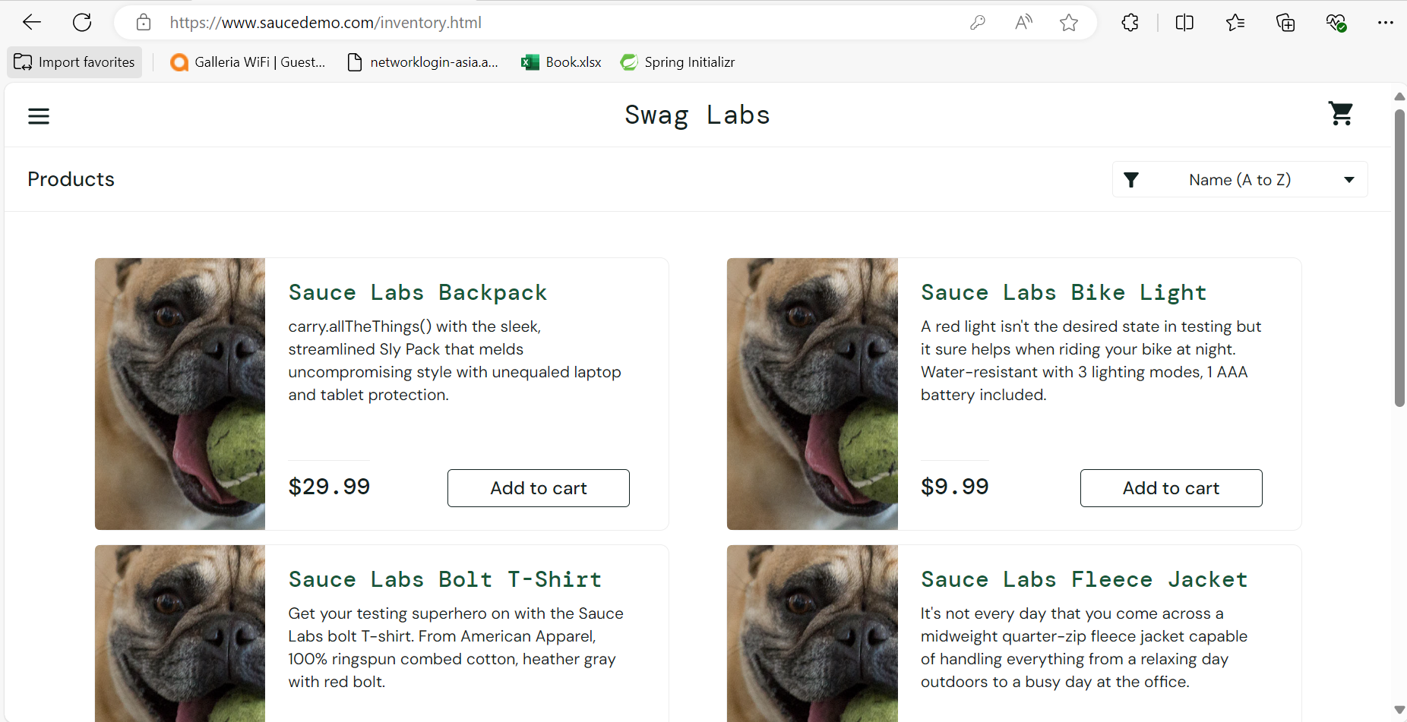
Learning is also Fun!
Group Activity: User story and test cases creation for saucedemo.com
Funny incident: We going awry from our track despite knowing all the concepts, which taught us how important it is to implement things to learn them better.

Slide 25

Summary
The sessions were interactive and full of learning. We got to know about a lot of concepts such as SDLC, Agile, STLC, User stories, test cases, Scrum, Scrum Ceremonies, Scrum Artifacts, DBMS, Cloud, DevOps, VM creation and working with it, etc. The sessions were detailed, understandable and enjoyable.
The topics for the upcoming week will include the technical concepts required for us as part of our team in the company.
The current week build a foundational base for the future. It will be helpful for us when we will be working with our teams on various projects.

Slide 26
Thank You

